Slide 1

Finding locations for a new Italian restaurant
Ricardo Pellegrini

Slide 2
Business Problem
When starting a new enterprise, it is very important to define the appropriate location for it, after all, the location of the enterprise has a major factor for success.
This project will help a young man to open an Italian restaurant. He lives in Berczy Park, and would like to find a region where there is no Italian restaurants nearby, and that is as close as possible to his specific neighborhood. With that, we will look for a place where there can be a good flow of people and the least possible competition.
For this, we must pay attention to places that do not yet have many Italian restaurants and have a minimum distance of Berczy Park.

Slide 3
Description of data
For this analysis, we will use the data collected through Wikipedia and Foursquare, where we'll be able to find the 10 most common venues categories in each region of Toronto. This dataset will contain details of the region, postal code, location, group (cluster label) and the most common types of business in each of the locations.
The Wikipedia page used is https://en.wikipedia.org/wiki/List_of_postal_codes_of_Canada:_M, to obtain the names of boroughs and neighborhoods of Toronto. The location (latitude and longitude) were obtained using dataset 'Geospatial_Coordinates.csv'. The number of restaurants, their location, and the types of venues in each Toronto neighborhood were obtained using Foursquare API.
This kind of information will give us the chance to choose a good place to start a new Italian restaurant, by avoid places where are already dominated by other restaurants of the same type.

Slide 4
Methodology
Create dataset of regions and assign them to your location.
Find the most common venue categories in each region.
Check similarity between regions using Clustering k-means.
Create subset of areas that have no/less Italian restaurants.
Add the distance between neighborhoods and Berczy Park to the subset.
Include the cluster label to this list.
Determine the best neighborhoods for the new Italian restaurant.

Slide 5
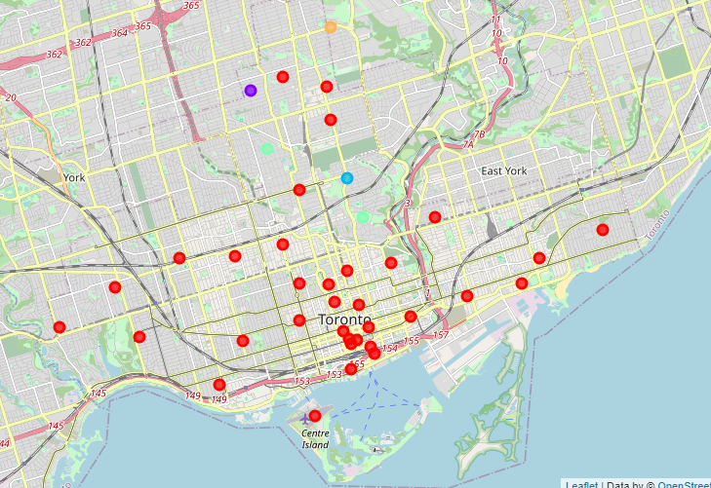
Clustering using K-Means
A new dataframe was made by adding the most common venues category for each of the neighborhoods.
Using the clustering algorithm K-Means of Scikit-Learn, we could classify these neighborhoods in 05 groups (clusters), as shown on the map.

Slide 6
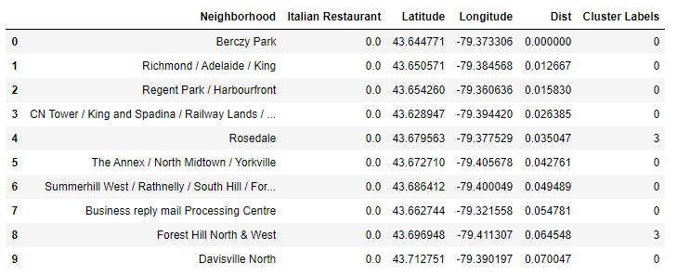
Nearest neighborhoods with no Italian restaurants
It was listed all the neighborhoods without any Italian restaurants and they were sorted by the nearest from the neighborhood Berczy Park.
To select just a few neighborhoods, we also considered the cluster group, picking just the first four neighborhood for another analysis.

Slide 7
Results
The neighborhood of Berczy Park doesn't have any Italian restaurant.
In addition to the neighborhood itself, we can put three more options, according to the distance and similarity due to the label clusters.
Considering these factors, four good choices of place to start this new business would be:
Berczy Park,
Richmond / Adelaide / King,
Regent Park / Harbourfront and
CN Tower / King and Spadina / Railway Lands.
To choose the best among these four, analyzes regarding price per square meter and property value must be taken into consideration.

Slide 8
Conclusion
With this project, we can identify a small list of potential location for a new italian restaurant based on the founders' criteria, which are distance and the existence of another italian restaurants.
Four neighborhoods were selected, including the neighborhood where the client resides, but his final choice may differ due to prices and market research issues.
Further analysis must be taken before the final decision, including market researches, prices and other pertinent offers.

Slide 9
Thank you very much for your attention.
Ricardo Pellegrini.

